Slide 1

Chapter 26
Creating Location-Aware Webpages Using Geolocation

Slide 2
Learning Objectives
How geoposition services determine a device’s location and the related accuracy of the result
How to enable geopositioning support
How to test if a browser supports geolocation
How to determine a current location using the geoposition API
How to support call-back functions within an application
How to track movement using the geoposition API
How to use the Google Maps API to map a location

Slide 3
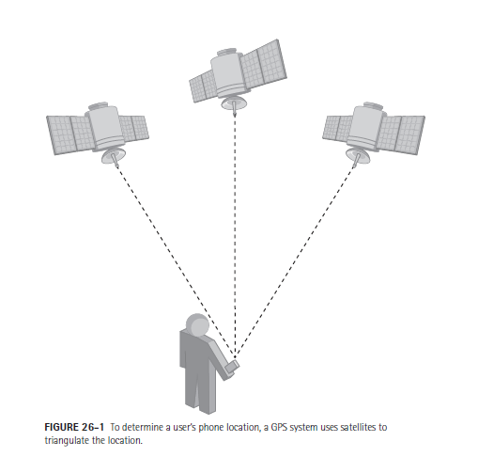
How Geopositioning Identifies Your Location

Slide 4
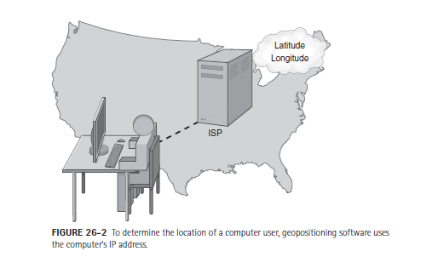
How Geopositioning Identifies Your Location

Slide 5
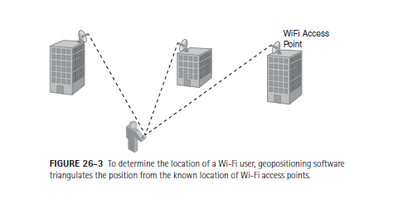
How Geopositioning Identifies Your Location

Slide 6
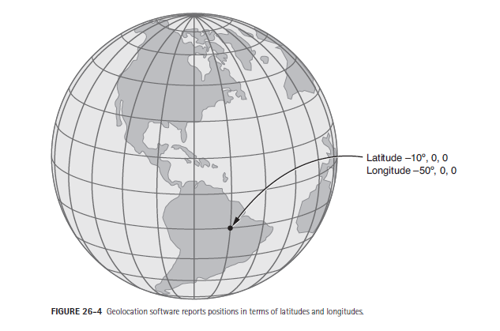
Working with latitudes and longitudes

Slide 7
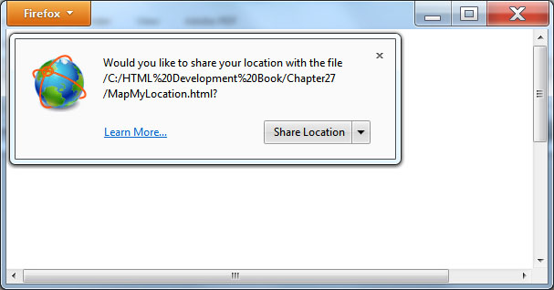
Enabling Geolocation Capabilities
As you might expect, many users are not thrilled by having applications with the ability to know where they are at or to track their movements.
To increase your privacy, browsers require enabling geolocation services for an application. Normally, you must respond to a browser prompt before the browser allows geolocation software to determine your position.

Slide 8
Testing for Browser Geolocation Support
<!DOCTYPE html> <html> <head> <script> function DisplaySupport() { if (navigator.geolocation) alert("Geolocation supported"); else alert("No geolocation support"); } </script> </head> <body onload="DisplaySupport()"> </body> </html>

Slide 9
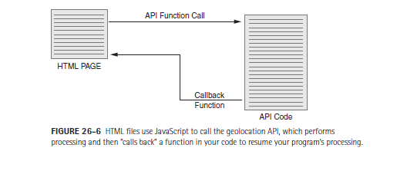
Understanding Call-Back Functions
Browsers implement geolocation services as an application program interface, or API. To use the API, place JavaScript statements within your HTML files that call specific functions that are built into the API.
Often, the API functions perform their processing and then pass back the result to your code by calling a function that you define, which developers refer to as a call-back function.

Slide 10
Simple example
<!DOCTYPE html> <html> <head> <script> function ShowPosition() { if (navigator.geolocation) navigator.geolocation.getCurrentPosition(DisplayResult, DisplayError) else alert("Browser does not support geolocation"); } function DisplayResult(Position) { var message = " Latitude: " + Position.coords.latitude; message += " Longitude: " + Position.coords.longitude; message += " Accuracy: " + Position.coords.accuracy + " meters "; alert(message); } function DisplayError(Error) { var message; switch(Error.code) { case 0: message = "Error retrieving location information"; break; case 1: message = "User prevented location access"; break; case 2: message = "Browser could not retrieve data"; break; case 3: message = "Browser timed out during data retrieval"; break; } alert(Message); } </script> </head> <body onload="ShowPosition()"> </body> <html>

Slide 11
Tracking a user’s position
Many phones now support built-in applications that provide real-time driving directions.
Rather than repeatedly calling the getCurrentPosition function to implement such processing, simply direct the geolocation software to monitor the user’s location and then notify the application of location changes by using, instead, the watchPosition API function.
After you call the watchPosition function, the API will continue to call back a function within your code as their location changes. To turn off the call-back processing, your code must call the clearWatch API method.

Slide 12
Integrating Google Maps
Across the Web, users make extensive use of the Google Maps website to obtain driving directions. As it turns out, Google provides a JavaScript-based interface that your HTML files can use to integrate the maps into the pages you create. Although Google Maps are not part of HTML 5, I am presenting them here because they fit nicely into the geopositioning processing.
Integrating Google maps into an HTML file is easy. To start, link in Google’s JavaScript code that provides their interface to the API:
<scriptsrc="http://maps.google.com/maps/api/js?sensor=false"></script>
Then, you use a <div> and </div> tag pair to specify a location in your page where you want the map to appear.

Slide 13
Mapping the whitehouse
<!DOCTYPE html> <html> <head> <script src="http://maps.google.com/maps/api/js?sensor=false"></script> <script> var map; function DisplayMap() { vargeocoder; geocoder = new google.maps.Geocoder(); varmapOptions = { zoom: 8, mapTypeId: google.maps.MapTypeId.ROADMAP, streetViewControl:true } map = new google.maps.Map(document.getElementById("mapLocation"), mapOptions); var address = "1600 Pennsylvania Blvd, Washington, D.C."; geocoder.geocode( { 'address': address }, ResultsCallBack); } function ResultsCallBack (results, status) { if (status == google.maps.GeocoderStatus.OK) { map.setCenter(results[0].geometry.location); var marker = new google.maps.Marker({ map: map, position: results[0].geometry.location }); } else alert("Geocode was not successful: " + status); } </script> </head> <body onload="DisplayMap()"> <div id="mapLocation" style="width: 640px; height: 480px;"></div> </body> </html>

Slide 14
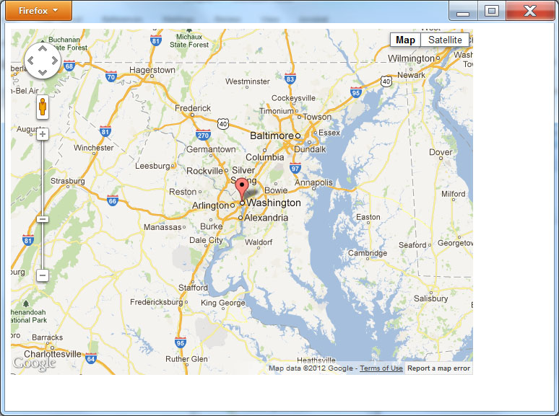
Result

Slide 15
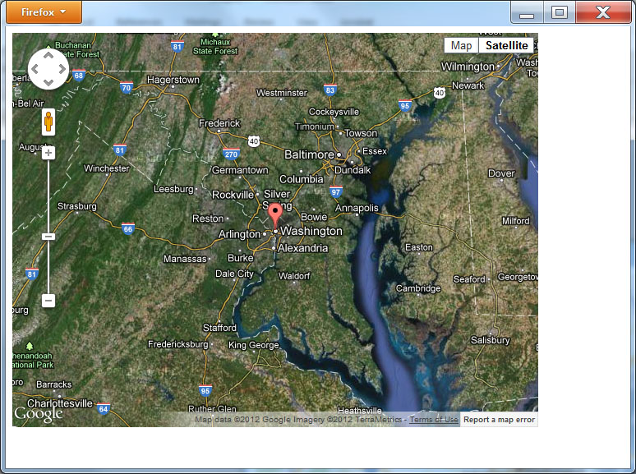
Satellite view

Slide 16
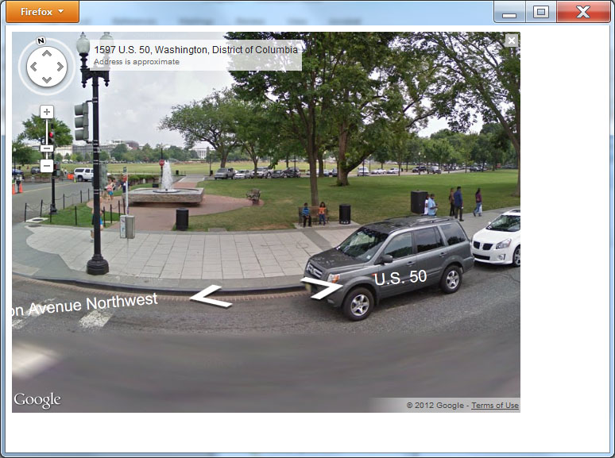
Street view

Slide 17
Mapping Your Current Location
<!DOCTYPE html> <html> <head> <script src="http://maps.google.com/maps/api/js?sensor=false"></script> <script> var map; function DisplayMap() { if (navigator.geolocation) navigator.geolocation.getCurrentPosition(DisplayResult, DisplayError) else alert("Browser does not support geolocation"); } function DisplayResult(position) { vargeocoder; geocoder = new google.maps.Geocoder(); varmapOptions = { zoom: 8, mapTypeId: google.maps.MapTypeId.ROADMAP, streetViewControl:true } map = new google.maps.Map(document.getElementById("mapLocation"), mapOptions); varlatlng = new google.maps.LatLng(position.coords.latitude, position.coords.longitude); geocoder.geocode({'latLng': latlng}, ResultsCallBack); } function ResultsCallBack (results, status) { if (status == google.maps.GeocoderStatus.OK) { map.setCenter(results[0].geometry.location); var marker = new google.maps.Marker({ map: map, position: results[0].geometry.location }); } else alert("Geocode was not successful: " + status); }

Slide 18
Mapping current location continued
function ShowPosition() { if (navigator.geolocation) navigator.geolocation.getCurrentPosition(DisplayResult, DisplayError) else alert("Browser does not support geolocation"); } function DisplayError(Error) { var message; switch(Error.code) { case 0: message = "Error retrieving location information"; break; case 1: message = "User prevented location access"; break; case 2: message = "Browser could not retrieve data"; break; case 3: message = "Browser timed out during data retrieval"; break; } alert(Message); } </script> </head> <body onload="DisplayMap()"> <div id="mapLocation" style="width: 640px; height: 480px;"></div> </body> </html>

Slide 19
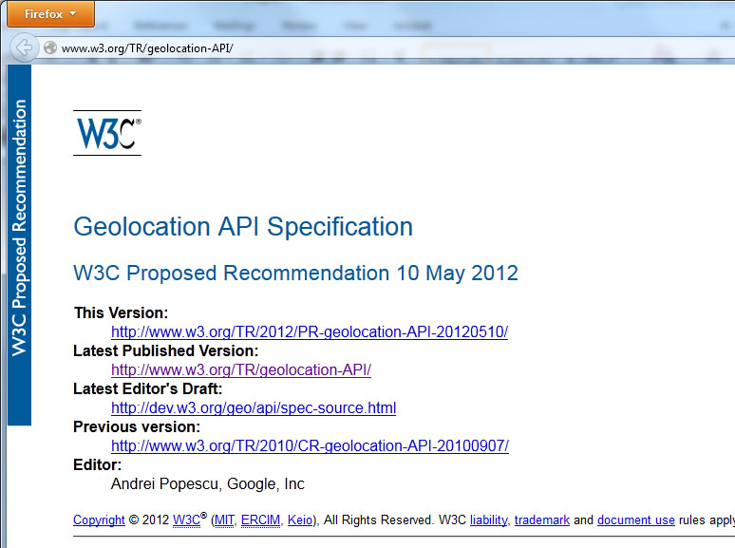
Real world design – geolocation api

Slide 20
summary
The use of geolocation changes how webpages interact with users. By determining a user’s location, a page can display more meaningful information, such as nearby stores, restaurants, and more.
Today, most mobile phones and hand-held devices provide GPS support. To make it easy for webpages to use geolocation data, HTML provides a geolocation API. This chapter introduced the use of the API.
In addition, this chapter presents ways to integrate Google Maps into your pages to provide street maps, satellite photos, and even street-level views of locations.

